Slide 1
Chicago Crime Probability Prediction Project
Rohith Sunkishala
Campus ID: MT29058

Slide 2
Chicago Crime Probability Prediction Project
• Predict crime occurrence probability in Chicago.
• Leverages machine learning for crime risk estimation.
• Includes extensive exploratory data analysis (EDA).
• Interactive web app developed using Streamlit.
• Supports real-time decision-making for public safety.

Slide 3
Problem Statement
Aim: Estimate likelihood of a crime happening.
Useful for policing and community safety strategies.
Identify risk factors like time, location, and category.
Assist in resource planning and safety initiatives.
Provide a predictive view of crime dynamics.

Slide 4
Dataset Overview
Data sourced from Chicago Data Portal (2019–2025).
Includes crime type, location, time, and coordinates.
Categorized as domestic vs non-domestic crimes.
Dataset used for both EDA and machine learning.
Large and diverse dataset enhances model accuracy.

Slide 5
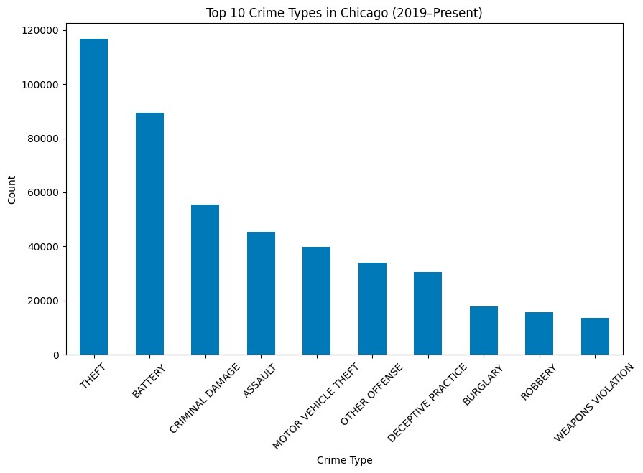
Crime Type Analysis
Most common crimes: Theft, Battery, Criminal Damage.
Theft contributes the highest proportion of crime.
Crime categories indicate behavioral patterns.
Helps identify major crime clusters in the city.
Important for selecting meaningful ML features.

Slide 6
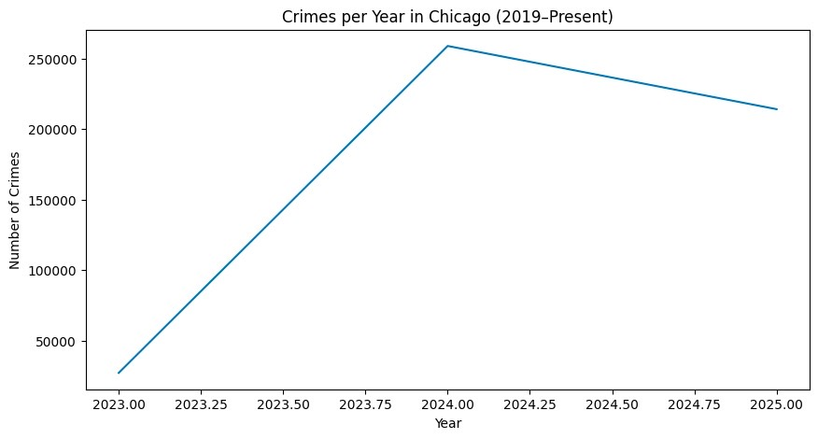
Crime Trends Over Years
• Crime trends vary significantly by year.
• 2024 shows the highest crime frequency.
• Temporal patterns influence prediction accuracy.
• Year and month used as essential input features.
• Trends help understand seasonality in crime rates.

Slide 7
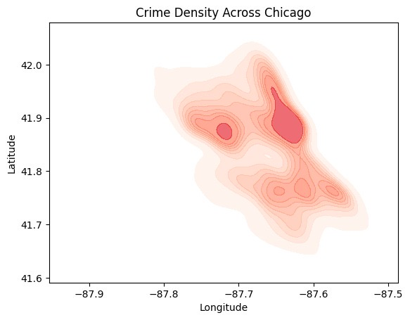
Crime Density Map
• Heatmap reveals high-crime hotspots across Chicago.
• North-east Chicago shows strong clustering.
• Spatial patterns inform safety policies.
• Critical for geospatial crime understanding.
• Supports hotspot-based policing strategies.

Slide 8
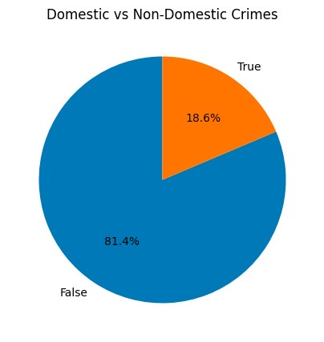
EDA: Domestic vs Non-Domestic Crimes
• Non-domestic crimes dominate with ~81%.
• Domestic crimes form a small proportion (~19%).
• Category imbalance impacts ML behavior.
• Highlights differences in crime intent/context.
• Useful for designing categorical features.

Slide 9
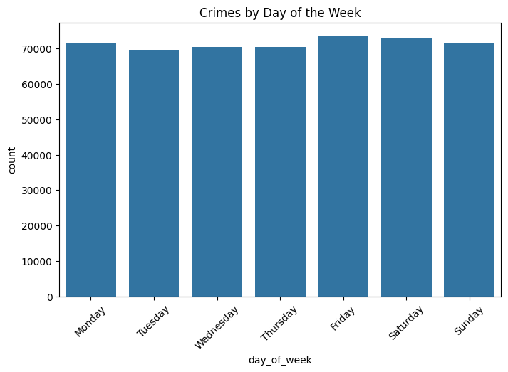
Weekly Crime Patterns
• Fridays show highest weekly crime activity.
• Tuesdays and Thursdays have the lowest crime counts.
• Weekly cycles influence prediction modelling.
• Important temporal feature for analysis.
• Supports detection of routine crime behaviors.

Slide 10
Feature Engineering
• Extracted hour, weekday, month, year from timestamps.
• Applied One-Hot Encoding to categorical fields.
• Normalized numerical inputs for consistency.
• Removed irrelevant/missing attributes.
• Prepared structured dataset for ML modeling.

Slide 11
Model Training Process
• Model chosen: Random Forest Classifier.
• Handles mixed data types effectively.
• Provides robust probability-based predictions.
• Performs well with large datasets.
• Reliable and interpretable ML approach.

Slide 12
Synthetic Negative Sampling
• Original dataset contains only crime cases (1).
• Generated synthetic 'no crime' records (0).
• Balanced dataset improves classifier fairness.
• Essential for accurate probability prediction.
• Prevents bias toward crime-only predictions.

Slide 13
Model Evaluation
• Achieved strong classification accuracy.
• Evaluated using accuracy and probability metrics.
• Good separation between crime and no-crime cases.
• Reliable for real-time predictions.
• Supports practical decision-making in deployment.

Slide 14
Streamlit App Overview
• User-friendly Streamlit interface created.
• Inputs include time, location, and crime type.
• Outputs probability score of crime occurrence.
• Dark-themed UI for clean visualization.
• Real-time response with ML model integration.

Slide 15
Prediction UI
• Screenshot showcasing prediction interface.
• Demonstrates user selections for inputs.
• Displays crime probability output clearly.
• Risk levels: Low, Medium, High shown visually.
• Highlights user interaction workflow.

Slide 16
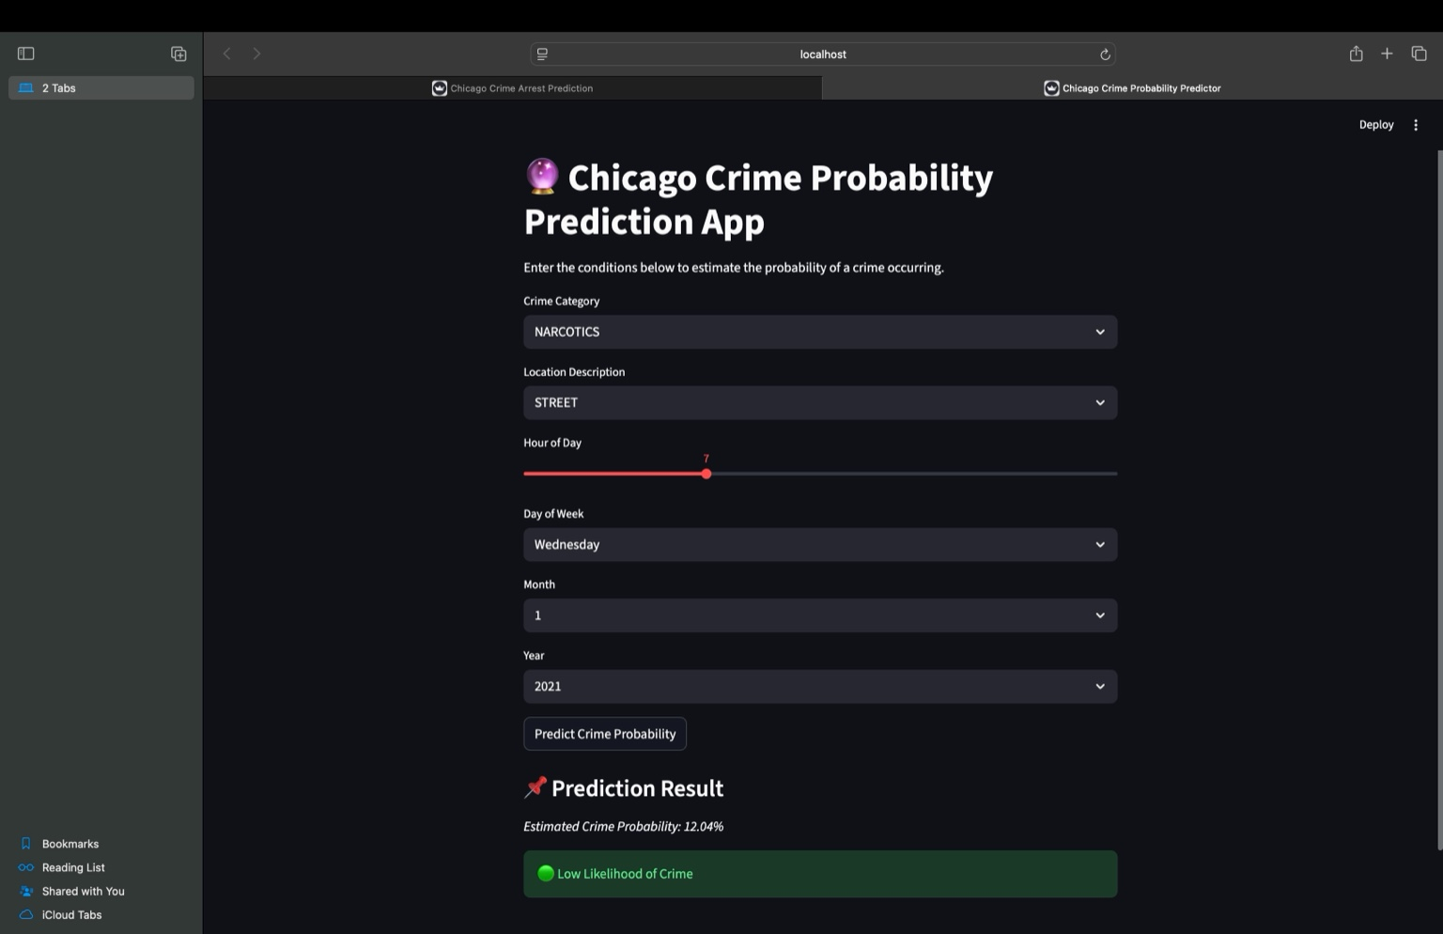

Slide 17
Conclusion & Future Scope
• Predictive model offers actionable crime insights.
• Future work: add real-time streaming crime data.
• Could include weather/socio-economic indicators.
• Potential deployment on cloud for public access.
• Extend system with deep learning enhancements.

